Slide 1
Oxidative phosphorylation
INTER 111: Graduate Biochemistry

Slide 2
Oxidative phosphorylation: Learning objectives
Define electron transport chain, oxidative phosphorylation, and coupling
Know the locations of the participants of the system/pathways
Predict the flow of electrons under standard state conditions when given a redox half equation and know how to calculate the standard state free energy change given the proper equation and half reactions. Be able to predict the spontaneity of a reaction given the reduction potential.
List components of the respiratory chain and the electron carrying molecules. Know the differences between the hemes.
Outline the pathway of electron transport in mitochondria in terms of the transfer of electrons from the reducing equivalents to oxygen.

Slide 3
Oxidative phosphorylation: Learning objectives
Describe the mechanism of action of an uncoupler or inhibitor on the electron transfer chain or oxidative phosphorylation.
Recognize the site of inhibition of rotenone, carbon monoxide, antimycin A, and oligomycin and be able to describe the effect of these inhibitors.
Describe and understand the mechanism of how the F_{o}F₁ ATPase complex forms ATP.
Estimate the net potential yield of ATP for each of the entry points into the electron transport system and know why there are discrepancies.

Slide 4
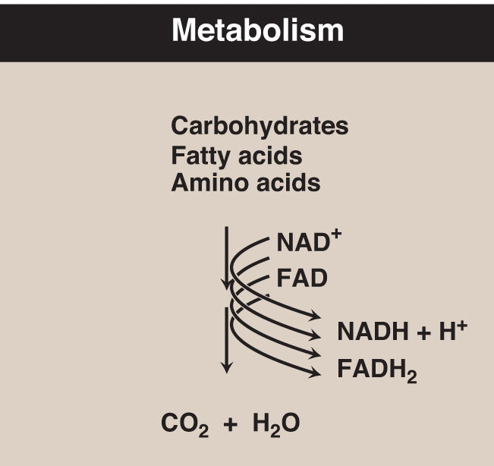
Most ATP is not directly produced during metabolism

Slide 5
Oxidative phosphorylation produces most cellular ATP
Glycogen
R5P
Glucose
disaccharides
NADH + H⁺
and
ATP
Pyruvate
aerobic
conditions
O₂
H₂O
NADH + H⁺
and FADH₂
and CO₂
Electron transport
Oxidative phosphorylation
Acetyl CoA
Acetyl CoA
citric
acid
cycle
ADP + P_{i}
ATP

Slide 6
Oxidative phosphorylation and the electron transfer chain are coupled
Oxidative phosphorylation
  is aerobic (i.e., in O₂)
  is a stepwise process
  transfers electrons from reduced carriers to O₂
  generates 3 moles ATP for every mole NADH
Electron transfer chain
  is a series of coupled oxidation-reduction reactions
  is catalyzed by membrane-bound proteins on the inner membrane of mitochondria

Slide 7
General principles of redox reactions
An oxidation-reduction (redox) reaction involves
an electron donor and an electron acceptor.
Fe²⁺ + Cu²⁺ Fe³⁺ + Cu⁺
oxidized
donor
reduced
acceptor
e⁻ donor
e⁻ acceptor
The redox potential expresses the tendency of an electron donor to reduce its conjugate acceptor.
Under standard conditions (25ºC, pH 7, [donor]=[acceptor]=1 M),
the redox potential is E_{o}’
E_{o}’ is measured relative to the standard hydrogen electrode.

Slide 8
Reduction potentials
Compounds with a large negative E_{o} are strong reducing agents.
Redox pair | E_{o}’ (V)
NAD⁺ / NADH FMN / FMNH₂ Cytochrome b Fe³⁺/Fe²⁺ 1/2 O₂ / H₂O | -0.32
 | -0.22
 | +0.07
 | +0.82
Compounds with a large positive E_{o} are strong oxidizing agents.

Slide 9
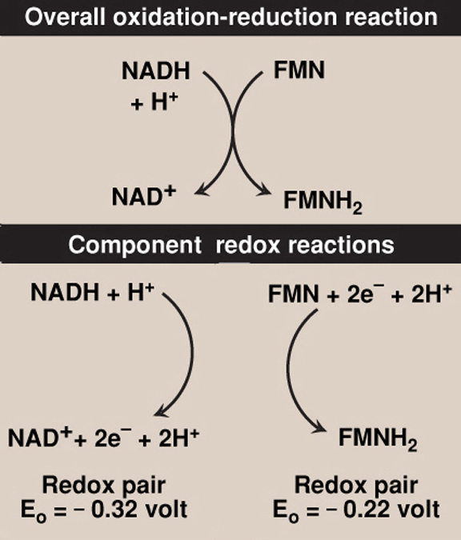
Coupled oxidation-reduction reactions

Slide 10
Respiratory electron carriers
Redox couples
E_{o}’
NAD⁺
- 0.32
NAD⁺ / NADH
NADH-Q reductase
(Complex I)
FMN
- 0.30
FMN / FMNH₂
Fe-S centers
Fe³⁺S / Fe²⁺S
2 e⁻ transfer
Q (mobile)
Coenzyme Q
+ 0.04
CoQ / CoQH₂
Cyto b (Fe³⁺)
+ 0.07
H-Fe³⁺ / H-Fe²⁺
Cyto bc₁
(Complex III)
Fe-S centers
Fe³⁺S / Fe²⁺S
Cyto c (Fe³⁺)
+ 0.23
H-Fe³⁺ / H-Fe²⁺
(mobile)
Cyto c (Fe³⁺)
+ 0.25
H-Fe³⁺ / H-Fe²⁺
Cyto oxidase
(Complex IV)
Cyto a (Fe³⁺)
+ 0.29
H-Fe³⁺ / H-Fe²⁺
Cyto a₃ (Fe³⁺)
+ 0.55
H-Fe³⁺ / H-Fe²⁺
O₂
+ 0.82
O₂ / H₂O

Slide 11
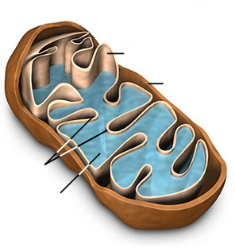
ETC and ATP synthase are on the inner mitochondrial membrane
inner membrane
outer membrane
Electron
transport
chain
NAD⁺
cristae
a
FMN
CoQ
c
b
matrix
a₃
a
ATP synthase

Slide 12
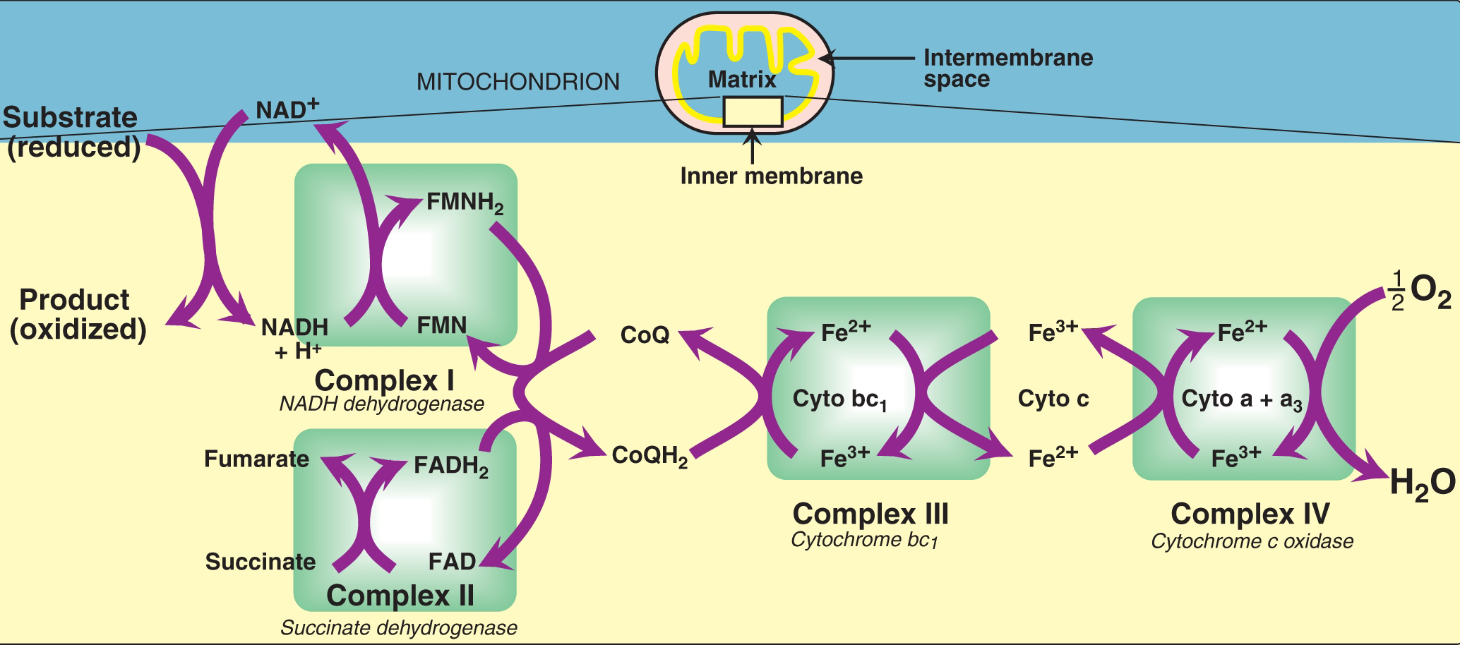
Mitochondrial electron transport chain organization
The electron transport chain conducts a series of oxidation/reduction reactions.
The components of the respiratory chain are flavoproteins, ubiquinone molecules, and cytochromes

Slide 13
Reactions in electron transport chain
Formation of NADH
  NAD⁺ is reduced to NADH by dehydrogenases in the TCA cycle.
NADH dehydrogenase
Coenzyme Q
Cytochromes
Substrate
(reduced)
NAD⁺
Product
(oxidized)
NADH + H⁺

Slide 14
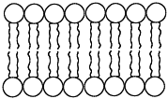
Mitochondrial electron transport chain
H₂O
1/2 O₂
+
2 H⁺
FMN
Cyto b
NADH
b_{H}
matrix
4Fe-4S
Cu_{B}
b_{L}
Cyto c₁
2Fe-2S
a₃
Q
QH₂
c₁
QH₂
2Fe-2S
a
intermembrane
space
Cyto c
Cu_{A}
F₁F_{O} synthase
Complex I
Complex III
Complex IV
NADH
dehydrogenase
cytochrome
bc₁
cytochrome
c oxidase

Slide 15
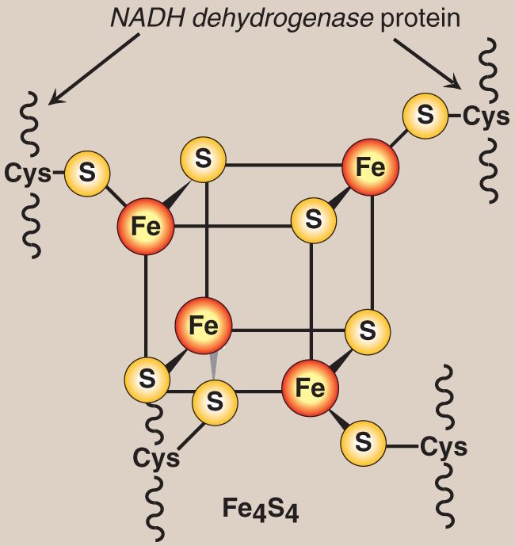
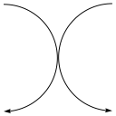
Complex I: NADH dehydrogenase
NADH + H⁺
FMN
Fe²⁺S
CoQ
reduced
oxidized
reduced
oxidized
NAD⁺
FMNH₂
Fe³⁺S
CoQH₂
oxidized
reduced
oxidized
reduced
FMN
NADH
matrix
4Fe-4S
2Fe-2S
Q
QH₂
QH₂
intermembrane
space

Slide 16
Reactions in electron transport chain
Formation of NADH
NADH dehydrogenase
Coenzyme Q
  A quinone derivative with long isoprenoid tail
  Mobile carrier that accepts hydrogens from FMNH2 (complex I) and FADH2 (Complex II).
  Transfers electrons to complex III
Cytochromes

Slide 17
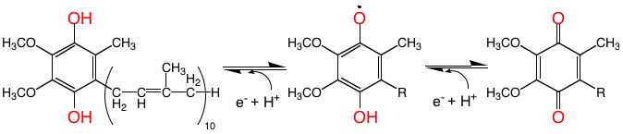
Redox states of coenzyme Q
Reduced form of coenzyme Q
(QH₂, ubiquinol)
Semiquinone intermediate
(QH•)
Oxidized form of coenzyme Q
(Q, ubiquinone)

Slide 18
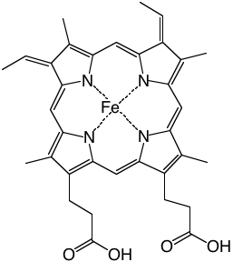
Complex III: cytochrome bc₁
Cyto b
matrix
b_{H}
b_{L}
Cyto c₁
QH₂
c₁
2Fe-2S
intermembrane
space
Cyto c
Heme

Slide 19
Complex IV: cytochrome c oxidase
Cyt ²⁺ c
Cyt ³⁺ a
Cyt ²⁺ a₃
1/2 O₂
Cyt ³⁺ c
Cyt ²⁺ a
Cyt ³⁺ a₃
H₂O
H₂O
1/2 O₂
+
2 H⁺
matrix
Cu_{B}
a₃
a
intermembrane
space
Cyto c
Cu_{A}

Slide 20
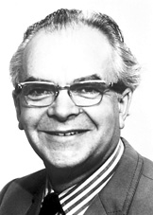
Chemiosmotic Coupling Theory
Three elements for energy transduction:
A cellular membrane
Exergonic electron transport generates a proton gradient across a membrane
Proton gradient furnishes energy for ATP production by ATP synthase
Peter D. Mitchell

Slide 21
Oxidative phosphorylation is indirectly coupled to electron transfer chain
ATP
H⁺
H
H₂O
ADP
+
P_{i}
1/2 O₂
+
2 H⁺
FMN
Cyto b
NADH
b_{H}
matrix
4Fe-4S
Cu_{B}
b_{L}
Cyto c₁
2Fe-2S
a₃
Q
QH₂
c₁
QH₂
2Fe-2S
a
intermembrane
space
Cyto c
Cu_{A}
H⁺
H⁺
H⁺
Complex V
ATP synthase
lower pH and greater positive charge

Slide 22
Oxidative phosphorylation is indirectly coupled to electron transfer chain
ATP
For 1 mol NADH oxidized, 3 mol ATP produced
H⁺
H
H₂O
ADP
+
P_{i}
1/2 O₂
+
2 H⁺
FMN
Cyto b
NADH
b_{H}
matrix
4Fe-4S
Cu_{B}
b_{L}
Cyto c₁
2Fe-2S
a₃
Q
QH₂
c₁
QH₂
2Fe-2S
a
intermembrane
space
Cyto c
Cu_{A}
H⁺
H⁺
H⁺
Complex V
ATP synthase
For 1 mol FADH₂ oxidized, 2 mol ATP produced

Slide 23
ATP synthase is also an ATPase
3
H⁺
ATP
ADP
+
P_{i}
When electrochemical H⁺ gradient is favorable, F₁F_{O} ATPase complex catalyzes ATP synthesis.
F₁
F₀
ATP
ADP
+
P_{i}
If no membrane potential or pH gradient exists to drive the forward reaction, K_{eq} favors the reverse reaction (ATP hydrolysis).
3
H⁺

Slide 24
ATP synthase
F₀ subunit
present with stoichiometry a, b₂, and c₁₀
F₁
F₀
F₁ subunit
present with stoichiometry α₃, β₃, γ, δ, and ε
α and β subunits (513 and 460 residues in E. coli) are homologous to one another
3 nucleotide-binding catalytic sites at α/β interface, but involving β residues
Each subunit contains ATP, but is inactive in catalysis
Mg²⁺ binds with adenine nucleotides in both α and β subunits
α
β
β
γ
α
α
β

Slide 25

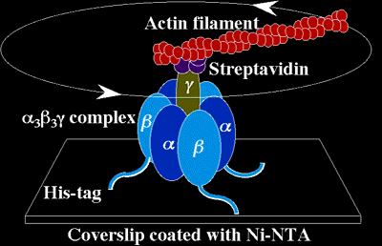
F₁F_{O} synthase
Rotation of the γ shaft relative to the ring of α and β subunits directly observed, by attaching fluorescent-labeled actin filament to the γ subunit.
  Noji et al. 1997 Nature 386, 299
The rotation rate is 100 Hz (revolutions/s)
ATP-induced rotation occur in discrete 120º steps.
http://www.res.titech.ac.jp/~seibutu/main_.html

Slide 26
2,4-dinitrophenol and aspirin are synthetic uncouplers
heat
FMN
Cyto b
matrix
b_{H}
4Fe-4S
Cyto c₁
Cu_{B}
b_{L}
2Fe-2S
a₃
Q
QH₂
c₁
QH₂
2Fe-2S
a
intermembrane
space
Cyto c
Cu_{A}
2,4-DNP
2,4-DNP
Complex V
ATP synthase

